Slide 1

Analyzing Video Game Sales Trends for Strategic Insights
By Noah Pidding

Slide 2
Introduction
Background:
The global video game industry, worth billions, spans consoles, PCs, and mobile platforms. With rapid growth and intense competition, understanding sales trends is crucial for success.
Problem:
The video game industry
is competitive and rapidly evolving, but stakeholders often lack detailed insights into sales trends.
Significance:
Help stakeholders make data-driven decisions to optimize development, marketing, and inventory.

Slide 3

Research Questions
How have global video game sales changed over time?
What game genres tend to perform the best across different regions?
Which platforms are the most successful in terms of sales (globally and across regions)? How have their sales changed over time?

Slide 4
Objectives
Analyze Global
Sales Trends
Evaluate Platform Performance
Asses Genre Popularity
Provide Strategic Insights
Identify how video game sales have evolved over time.
Determine which platforms are most successful in terms of year and region.
Examine which game genres perform the best within specific regions.
Provide actionable recommendations to optimize game development, marketing, and inventory management.

Slide 5

Hypothesis
Global:
  Technology as a whole has evolved over the years, leading to an overall increase in video game popularity and sales.
Genre Impact:
  RPGs will be more popular in Japan, while action and sports games will dominate in North America and Europe.
Platform Preferences:
  PlayStation and Xbox will lead in Western markets, while Nintendo platforms will be more successful in Japan..

Slide 6

Data Preprocessing
Description of Dataset:
  Source: Kaggle’s Video Game Sales Dataset
  Size: Contains about 16000 rows and 11 columns.
  Key Variables:
    Platform, Game Title, Genre, Year of Release, Regional & Global Sales.
Problems in Dataset:
  Missing Values:
    Converted 'Year' to numeric, coercing errors to NaN, and then dropped NaN values.
  Duplicates:
    Removed duplicate rows.
  Platform Names:
    Removed leading/trailing whitespace in 'Platform' column for consistency.
Notes:
Note: dataset only contains up to year ~2020 & couldn’t find dataset with video game sales for more recent years

Slide 7
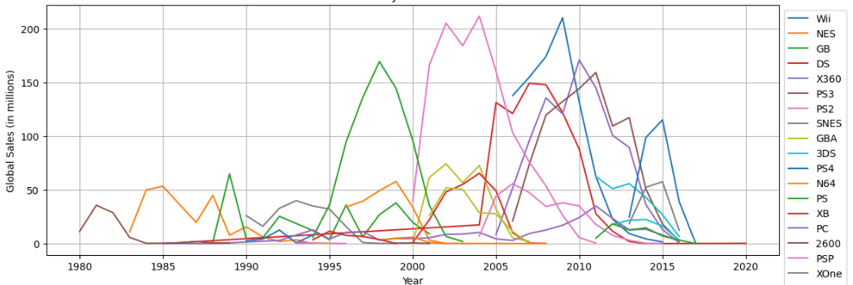

Global Sales by Platform Over Time

Slide 8
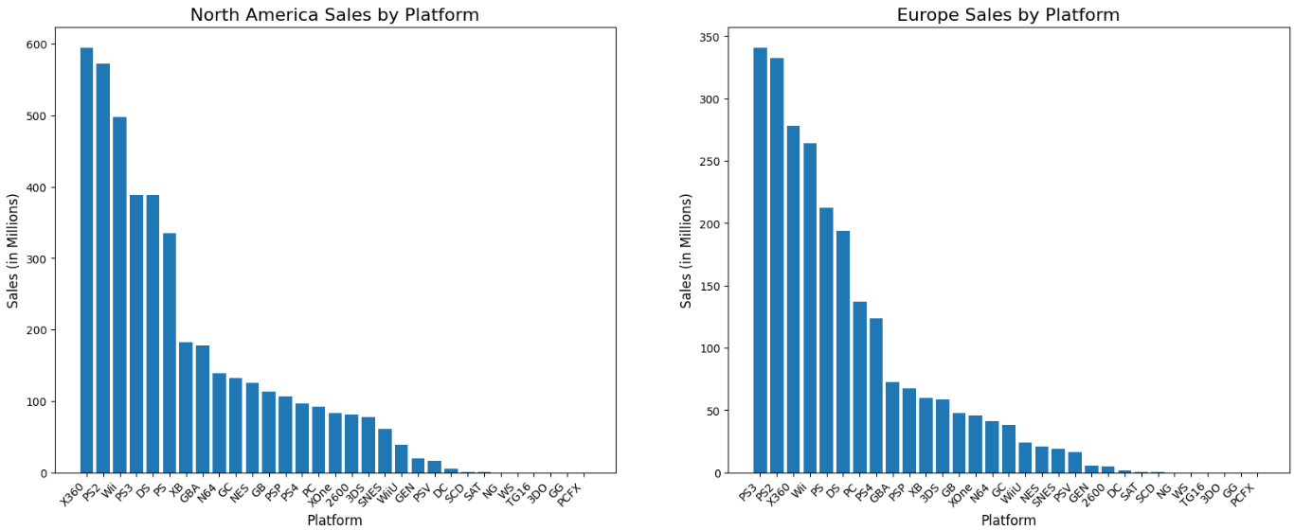
Platform Sales by Region

Slide 9
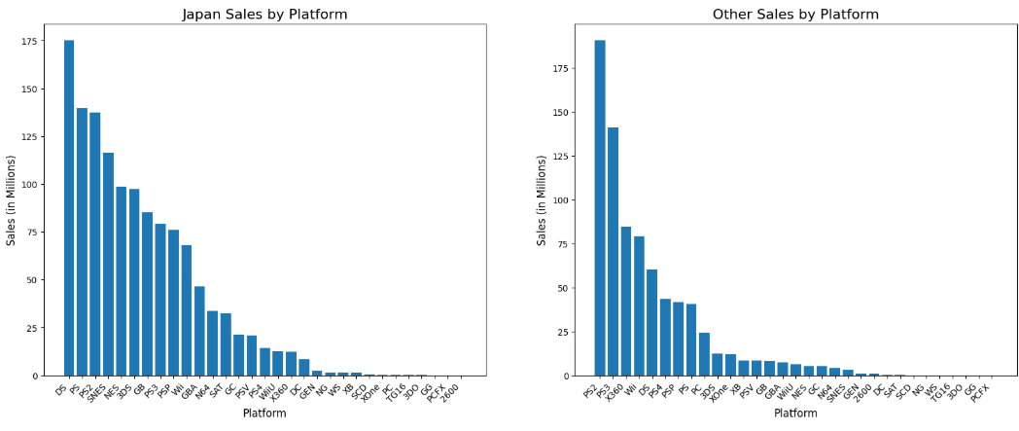
Platform Sales by Region

Slide 10
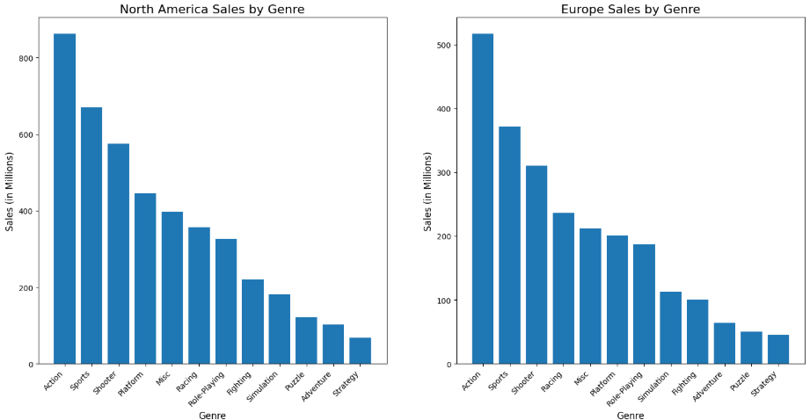
Genre Sales by Region

Slide 11
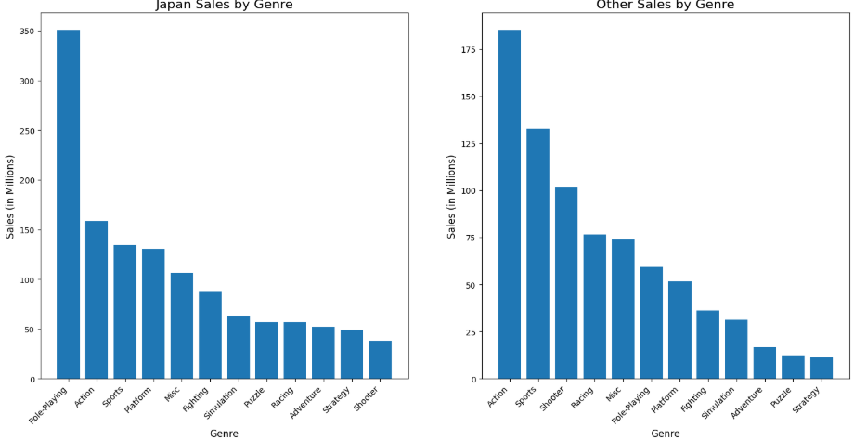
Genre Sales by Region

Slide 12

Data Analysis
Approach:
  Conducted data cleaning (handled missing values, removed duplicates, standardized text fields).
  Grouped data by platform, genre, and region to analyze sales trends and performance patterns.
  Applied ridge regression model to quantify relationships between key variables.
Key Variables:
  Dependent Variable: Region sales
  Independent Variables/Features: Release year, Platform, Genre & Publisher
Notes:
Ridge regression model: type of linear regression that helps prevent overfitting, especially when you have many related (correlated) variables. It adds a penalty to the model, which keeps the coefficients (weights) small and stable.

Slide 13
Data Analysis
Methods:
  One-Hot Encoding: Handled categorical variables like platform and genre.
  Standardization: Scaled numerical data to ensure consistency.
  Visualization: Generated trend analyses and bar charts using Matplotlib to identify patterns across genre and platforms
Model Performance:
  Used Ridge regression model with Region Sales as target variables and features including key variable columns as independent variables.
  MSE = 0.4 - low MSE means the predictions are very close to the actual values of global sales.
  R² = 0.12 - low R² means the model doesn’t effectively capture the relationship between the features and region sales trends.
Notes:
One hot encoding: converts categorical data (like labels) into a numerical format for machine learning models. Each category becomes a new column. Rows get a 1 in the column for their category and 0 in others.
Standardization: scales data so it has a mean of 0 and a standard deviation of 1. Makes all features contribute equally, especially when they have different units or ranges.

Slide 14

Key Findings
01
Sales have generally increased, peaks from 1995-2015 (new console releases).
Global Sales Trends:
02
NA & EU: Action and sports games dominate.
Japan: RPGs are the most popular genre.
Regional Preferences:
03
PlayStation and Xbox lead globally, especially popular in NA and EU.
Nintendo platforms like the DS are particularly popular in JP
Platform Performance:

Slide 15

Insights & Recommendations
Developers:
  Align game development with regional preferences (e.g., RPGs in Japan, action/sports games in North America/Europe) to boost engagement and profitability.
  Plan major releases alongside new console launches to maximize impact.
Publishers:
  Tailor marketing campaigns to regional genre popularity.
  Focus on PlayStation and Xbox for Western markets and Nintendo platforms for Japan.
Retailers:
  Optimize inventory and promotions based on regional and seasonal trends (e.g., RPGs in Japan during holidays, sports games in Europe during events) to reduce costs and improve customer satisfaction.

Slide 16
Questions?

